Slide 1
Physical Database Design and Performance
Chapter 5
Modern Database Management
12th Edition
Hoffer, Ramesh, and Topi

Slide 2
Learning Points
Describe Physical Database Design Process
Concepts and Issues for Designing Fields
Concepts and Issues for Designing Physical Files
Discussion of RAID Technology
Introduction to Database Structures

Slide 3
Physical Database Design
Purpose–translate the logical description of data into the technical specifications for storing and retrieving data.
Goal–create a design for storing data that will provide adequate performance and insure database integrity, security, and recoverability.

Slide 4
Physical Design Process
Inputs
Decisions
Normalized relations
Volume estimates
Attribute definitions
Response time expectations
Data security needs
Backup/recovery needs
Integrity expectations
DBMS technology used
Attribute data types
Physical record descriptions (doesn’t always match logical design)
File organizations
Indexes and database architectures
Query optimization
Leads to

Slide 5
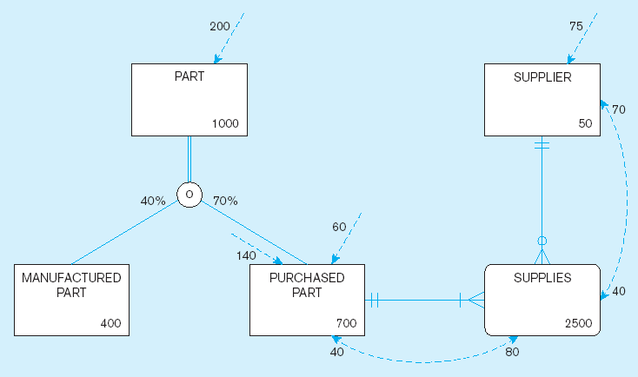
Data Volume and Usage Map

Slide 6
Data Volume and Usage Map (cont.)
Data volumes

Slide 7
Data Volume and Usage Map (cont.)
Access Frequencies (per hour)

Slide 8
Data Volume and Usage Map (cont.)
Usage analysis:
140 purchased parts accessed per hour ➔
80 quotations accessed from these 140 purchased part accesses ➔
70 suppliers accessed from these 80 quotation accesses

Slide 9
Data Volume and Usage Map (cont.)
Usage analysis:
75 suppliers accessed per hour ➔
40 quotations accessed from these 75 supplier accesses ➔
40 purchased parts accessed from these 40 quotation accesses

Slide 10

Designing Fields
Field: smallest unit of data in a database.
Field design involves
  Choosing data type
  Coding and compression
  Controlling data integrity
  Handling missing values

Slide 11
Choosing Data Types
CHAR–fixed-length character
VARCHAR2–variable-length character
LONG–variable-length character strings
NUMBER–positive/negative number
INTEGER–positive/negative whole number
DATE–actual date
BLOB–binary large object (graphics, sound clips, etc.)

Slide 12
Coding and Compression Techniques
Some attributes have a sparse set of values or large data volumes, considerable storage space will be consumed.
A field with a limited number of possible values can be translated into a code that requires less space.

Slide 13
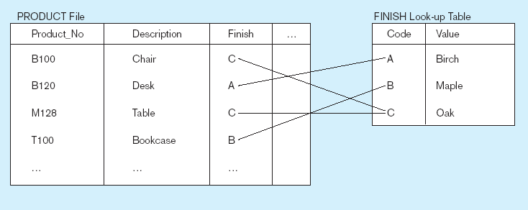
Example of Coding and Compression
Code saves space, but costs an additional lookup to obtain actual value

Slide 14
Controlling Field Data Integrity
Default value – assumed value if no explicit value.
Range control – allowable value limitations.
Null value control – allowing or prohibiting empty fields.
Referential integrity – foreign-key to primary-key match-ups.

Slide 15
Handling Missing Data
Substitute an estimate of the missing value (e.g., using a formula).
Construct a report listing missing values to help resolve unknown values.
Perform sensitivity testing and ignore missing data unless the value is significant.

Slide 16
Physical Records
Physical Record: A group of fields stored in adjacent memory locations and retrieved and written together as a unit by a DBMS.
Page: The amount of data read or written in one I/O operation.
Blocking Factor: The number of physical records per page.

Slide 17
Designing Physical Files
A physical file is a named portion of secondary memory allocated for the purpose of storing physical records.
A file organization is a technique for physically arranging the records of a file on secondary storage devices.

Slide 18

File Organizations
Factors for selecting file organization:
  Fast data retrieval and high throughput
  Efficient storage space utilization
  Protection from failure and data loss
  Minimizing need for reorganization
  Accommodating growth
  Security from unauthorized use

Slide 19
Types of File Organizations
In a sequential file organization, the records are stored in sequence according to a primary key value.
In an indexed file organization, an index is created to locate individual records.
In a hashed file organization, the address of each record is determined using a hashing algorithm.

Slide 20
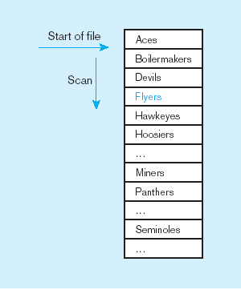
Sequential File Organization
Records of the file are stored in sequence by the primary key field values.
Every insert or delete requires resort; average time to find desired record = n/2
n

Slide 21
Indexed File Organizations
An index is a table that is used to determine the location of rows in a file that satisfy some condition.
A secondary index allows each entry to point to more than one record.
Primary keys are automatically indexed.
Oracle has a CREATE INDEX operation, and MS ACCESS allows indexes to be created for most field types.

Slide 22
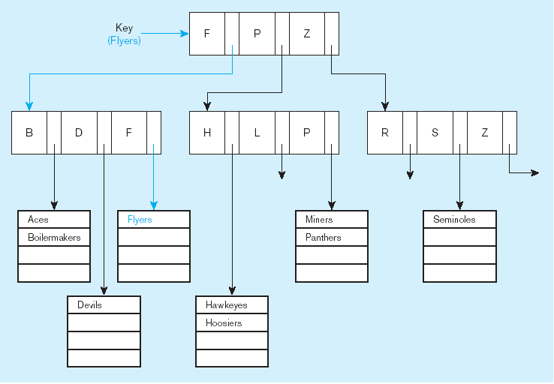
An Example of Index
Leaves of the tree are all at same level;
consistent access time.

Slide 23
Pointer
A pointer is a field of data that can be used to locate a related field or record of data.
In most cases, a pointer contains the address, or location, of the associated data.
Pointers are used in a wide variety of data storage structures.

Slide 24
Rules for Using Indexes
Use on larger tables.
Index the primary key of each table.
Index fields frequently in WHERE clause.
Index fields in ORDER BY and GROUP BY clauses
When there are >100 values but not when there are <30 values.

Slide 25
Rules for Using Indexes (cont.)
Avoid use of indexes for fields with long values; perhaps compress values first.
Surrogate key may be used as an index.
DBMS may have limit on number of indexes per table and number of bytes per indexed field(s).
Null values will not be referenced from an index.

Slide 26
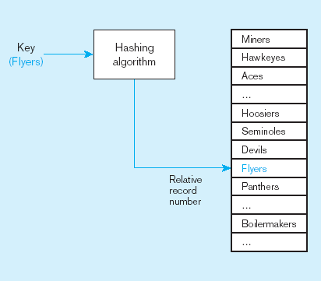
An Example of Hashed File
A hash algorithm is a routine that converts a primary key value into a record address.
Hash algorithm
Usually uses division-remainder to determine record position.

Slide 27
Clustering Files
In some relational DBMSs, related records from different tables can be stored together in the same disk area.
Useful for improving performance of join operations.
Primary key records of the main table are stored adjacent to associated foreign key records of the dependent table.
e.g. Oracle has a CREATE CLUSTER command.

Slide 28
RAID
RAID – Redundant Array of Inexpensive Disks
A set of disk drives that appear to the user to be a single disk drive.
Allows parallel access to data (improves access speed).
Pages are arranged in stripes.

Slide 29
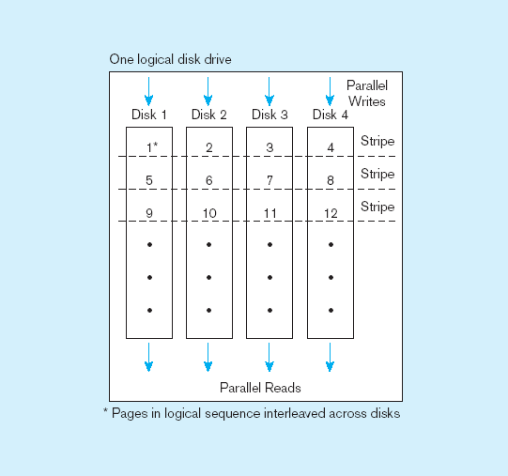
An Example of RAID
Here, pages 1-4 can be read/written simultaneously.

Slide 30
Database Structure
Hierarchical database model – files are arranged in a top-down structure.
Network database model – each file may be associated with an arbitrary number of files.
Relational database model – the most common database model for new systems.
Object-oriented database model – attributes and operations are encapsulated in structures called object.
Multidimensional database model – use dimensions to categorize the raw data.

Slide 31
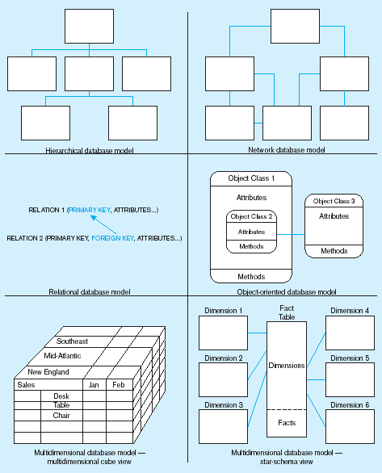
Database Structure
Legacy
Systems
Current
Technology
Data
Warehouses

